Slide 1

Planning For Huge Scale: Designing Your Pipelines for Scalability and Resiliency
Avan Mathur | Product Manager amathur@electric-cloud.com | @avantika_ec

Slide 2

What do I Mean by Huge Scale?
A Fortune 5 Bank
Deploying to 140K endpoints
6000s of applications on-boarded at accelerated pace
Chip Manufacturer
100K Jobs/Day
Constant load on the system
High job throughput

Slide 3

Plan Ahead – Know Your End Goal
Estimate and plan for long term scale
Define your success criteria
# of deployments per window
Max duration of a deployment
Number of concurrent deployments
Benchmarking
Validate numbers with benchmarks
Testing real workloads in real environments

Slide 4
Metrics to Measure
CI Cycle Times
Deployment Frequency and Duration
Concurrent Deployments
Release Frequency
Notes:
Ci Cycle time – more explanation – not only build time but including test that needs tobe run

Slide 5
Focus Areas
Infrastructure
Data
Pipeline Design
Monitoring / feedback loop

Slide 6

Infrastructure
High Availability
Horizontal Scalability
Distribute load and components
Database sizing and reliability
Understand and plan for bottlenecks and hardware limitations

Slide 7
Recommended Architecture
Site 1
Agent
Site 2
Agent
Agent
Agent
Database
Agent
Workspace
Commander Server
HA/
HS
Browser
Commander Server
Clustered Orchestration Servers
Web Server
Repository 2
WAN
Workspace
Repository 1
Browser
Web Server
Agent
Agent
Agent
Agent
Agent
Agent
Site 3
Agent
Agent
Agent
Agent
Workspace
Web Server
Repository 3
Browser
Notes:
Say that it is not ElectricFlow specific
Give it more example – site1 is NA, site2 is ASIA, site3 is AWS
Artifact Repositoru – put a replication policy in place – only replicate what is required for that site
Distaster Recovery

Slide 8
Disaster Recovery Architecture
Primary Site
DR Site
Database
DB Mirroring
Database
Commander Server
HA/
HS
Commander Server
HA/
HS
Commander Server
Commander Server
Clustered Orchestration Servers
WAN
Clustered Orchestration Servers
Workspace
Repository 1
Workspace
Repository 1
Disk Replication
Web Server
Agent
Web Server
Agent
Agent
Agent
Agent
Agent
Agent
Agent
Agent
Agent
Notes:
Say that it is not ElectricFlow specific
Give it more example – site1 is NA, site2 is ASIA, site3 is AWS
Artifact Repositoru – put a replication policy in place – only replicate what is required for that site
Distaster Recovery

Slide 9
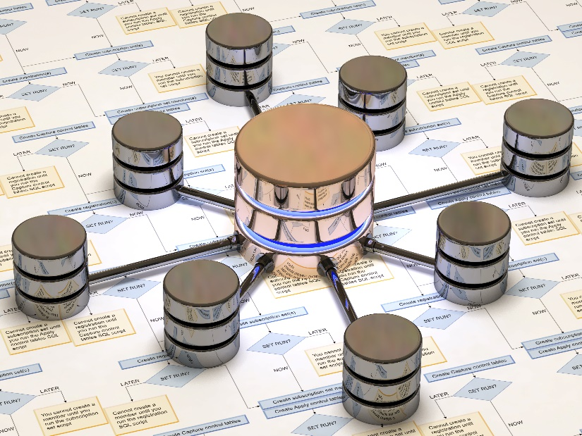
Managing Data
Each process generates data
Metadata, log files, build & test data, monitors, artifacts …
Understand growth rates and plan accordingly
Different areas to monitor
Database
Filesystem
Artifact Repository
Establish Data Retention & Archiving Policies early

Slide 10
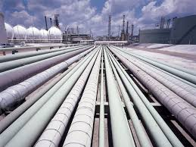
Pipeline Design: Scaling Across an Organization
Plan and monitor for performance at scale at every step
Build a generic model to standardize across apps
Reusable components that can be used across projects
Automated onboarding of new projects
Plan and Define Access Controls and Roles early in the process
Notes:
#1 EXAMPLE – for example, instead of making a separate model for each and every dployment. Identify the processes and components that are being used across apps, and
#2 EXAMPLE – what are the common pieces that can be reused
#5 -- needs concrete example. Transition to next slide. How would you design a taxing processdifferently for better throughput

Slide 11

Monitoring
Monitor key metrics
Understand patterns
Foresee upcoming peaks in usage
Plan ahead for hardware expansion
or distribution
Best Practices
Unobtrusive
Automated
Not only in production
One pane of glass
Notes:
Because its is mission critical – driving your enditre software delivery pipelines.
Single dashboard centralized for monitoring all of the activities across all of the tools and activities. Shared data being read from different tools and processes in one place.
One server and one agent is easy to monitor – once you scale to 1000s of deployments, oyu need one central place where you can see all activity
Monitors can feed into delivery platform to react to events

Slide 12
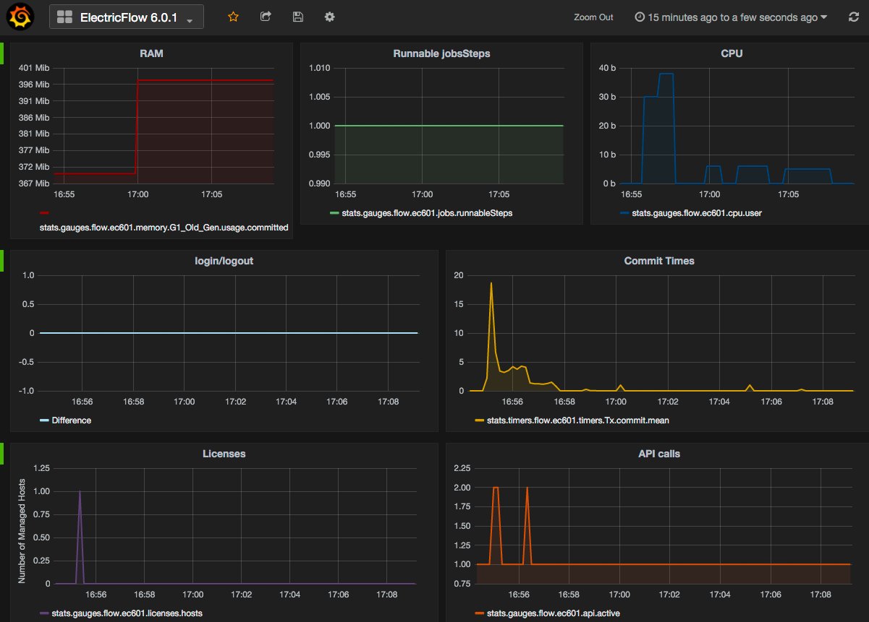
Monitoring
Notes:
HP – who is also talking at the conference - feeds monitoring data back into ChatOps to alert people or perform automated actions
WRAP UP – the system is mission critical to many of our customers – if it goes
Questions slides at the end.
Add community edition link at the end.

Slide 13
Questions?

